Slide 1

Advancing Innovation: Our Drug Development Pipeline Progress
A Journey from Discovery to Patient Impact
This presentation provides a comprehensive overview of the significant milestones achieved and the strategic path forward in our drug development pipeline. We aim to clearly articulate the progress made, highlight the critical steps ahead, and underscore the profound importance of our work in bringing new therapies to patients.

Slide 2

Foundational Steps: Discovery & Preclinical Success
Q1 2024: Discovery Phase Completed - Successfully identified 3 promising lead compounds, establishing a strong foundation for future therapeutic development.
Q4 2024: Preclinical Testing Concluded - Demonstrated encouraging efficacy and safety profiles in initial studies, validating our scientific approach and readiness for clinical trials.

Slide 3
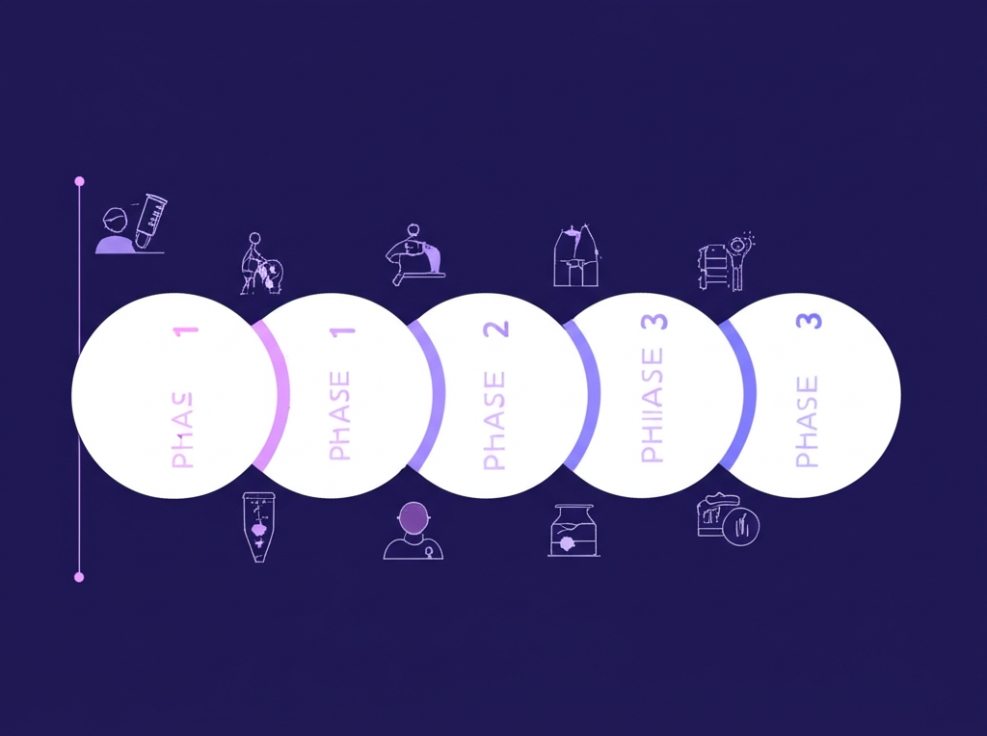
Clinical Progression: Moving Towards Human Impact
Q1 2025: Phase 1 Clinical Trial Launched - Successfully completed with 50 healthy volunteers, confirming initial safety and tolerability of our lead compound.
Q3 2025: Phase 2 Trial Underway - Currently enrolling 120 patients to optimize dosage and gather preliminary efficacy data, bringing us closer to patient solutions.

Slide 4
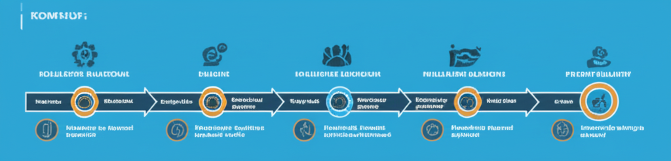
Horizon Ahead: Phase 3 & Regulatory Pathways
Our trajectory is set for continued advancement. Following the successful completion of Phase 2, we are meticulously preparing for the pivotal Phase 3 clinical trial. This crucial stage will involve a larger patient population to confirm efficacy and monitor adverse effects, providing the comprehensive data required for regulatory approval. Our ultimate goal is to submit our regulatory application by Q2 2026, bringing our innovative therapy one step closer to patients in need. This phase represents a significant investment in time and resources, but its successful execution is paramount to achieving our mission of improving human health.

Slide 5
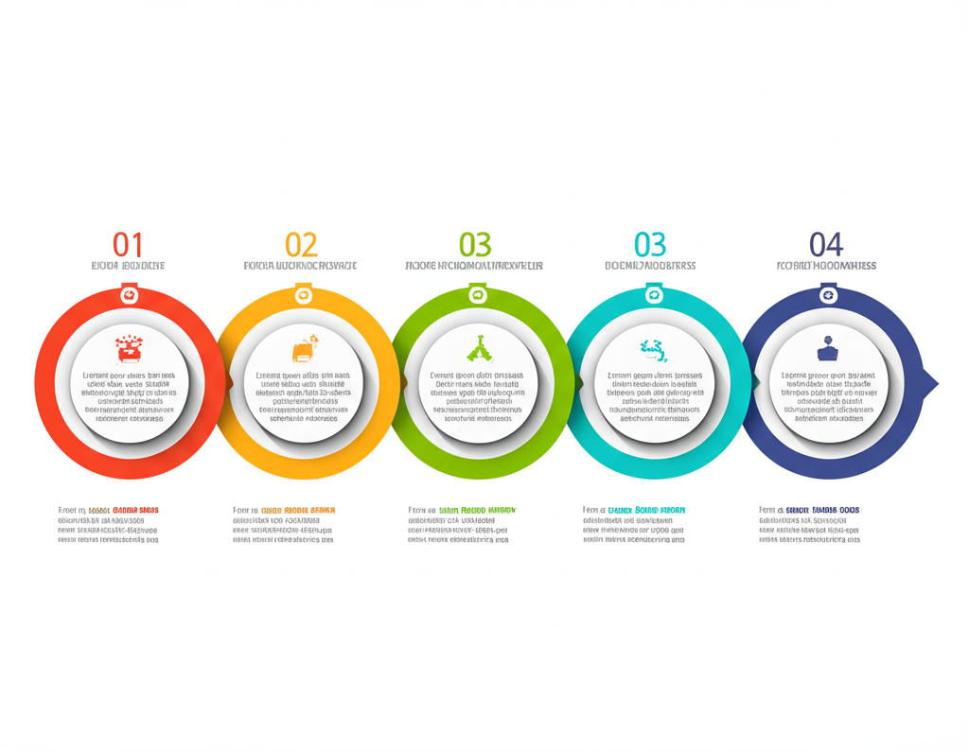
Our Progress at a Glance & What's Next
Successful Discovery & Preclinical Completion: Established a strong scientific foundation.
Positive Phase 1 Safety Profile: Validated initial human tolerability with no major safety concerns.
Phase 2 Trial Actively Advancing: Gathering critical efficacy and optimal dosing data.
Upcoming Phase 3 & Regulatory Submission: Strategically planned for Q2 2026, targeting market entry.
Driving Innovation for Patient Health: Our unwavering commitment to delivering impactful therapies remains our guiding principle.

